Slide 1

Credit Risk Assessment of Home Credit Group
Mentored by:
Sravan Malla
Submitted by:
Vyshnavi
Shashank
Sandeep
Sasikiran
Vivek

Slide 2

Problem Definition:
Situation
Complication
People struggle to get loans due to insufficient or non-existing credit history.
This population is taken advantage by untrustworthy lenders.
Objective
Scope
Predict the home loan credit risk for the financial institution.
Enables bank to reduce risk of loan defaults.
Additional Benefit
Understanding the customer base and market the right product to them .

Slide 3

Dataset Description:
It is a classification problem.
Data set consists of 122 columns including target variable with 307511 rows.
17 categorical and 105 numerical columns are present.
About 25% of null values are present in the dataset.
Challenges faced:
Imbalanced Dataset
01
01
Sampling methods
02
02
Null Values
Imputing methods
03
03
Size of Data
Google Collab

Slide 4
Road Map to Project:
EXPLORATORY DATA ANALYSIS
STATISTICAL ANALYSIS
BASELINE MODEL
1
2
3
2
DATA
SELECTKBEST
PCA
5
4
5
4
ENSEMBLE
EVALUATION
6
7
6
7
BUSINESS
SOLUTION

Slide 5
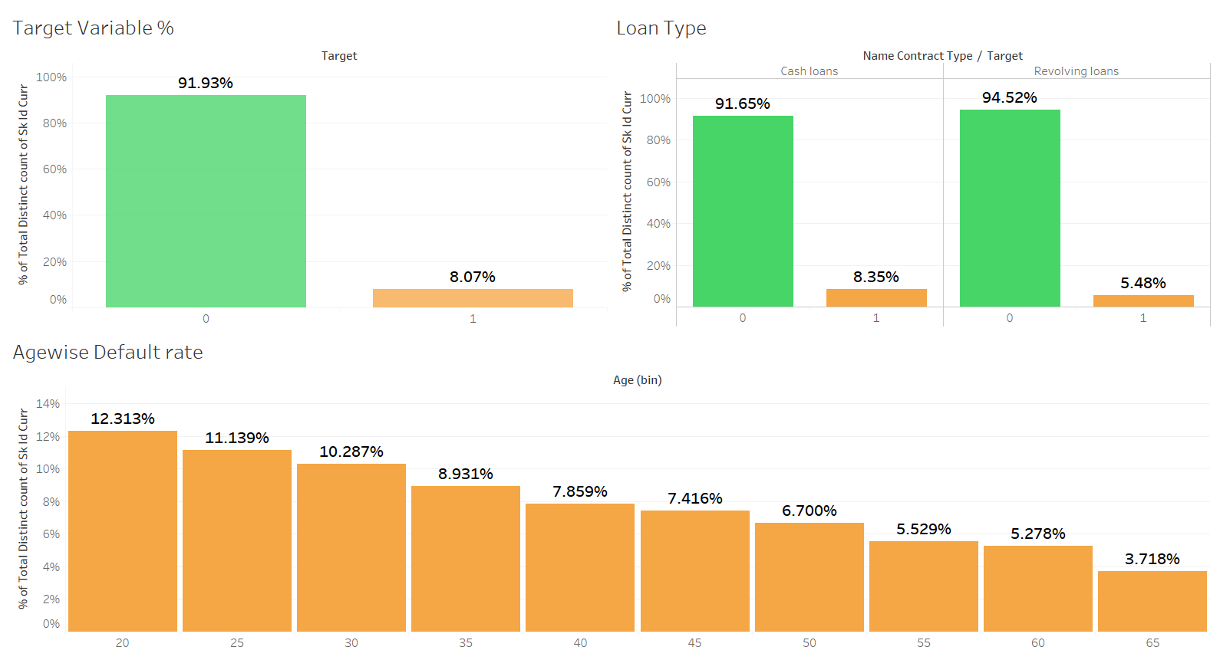
EDA

Slide 6
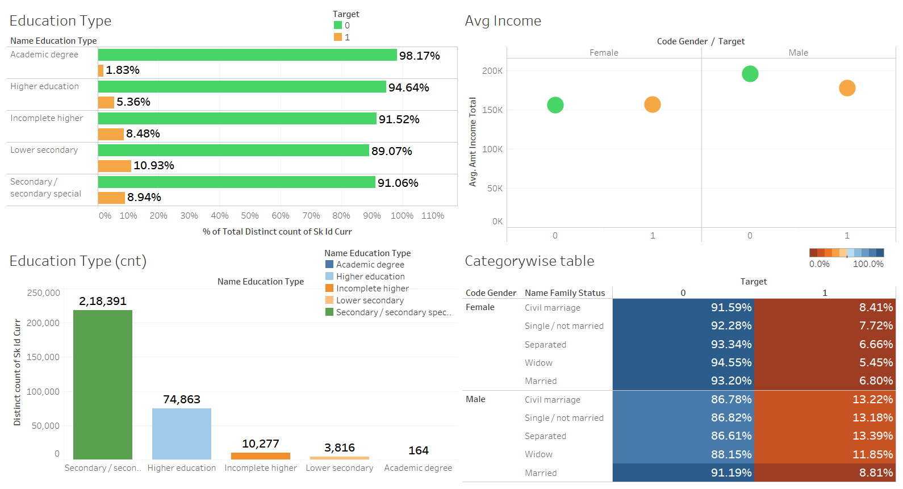

Slide 7
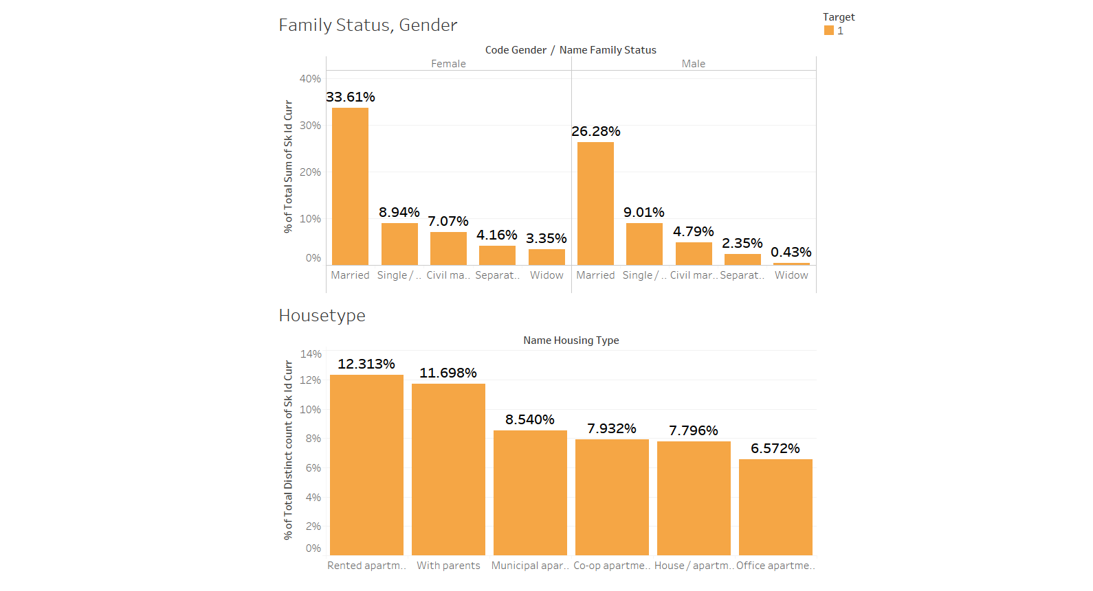

Slide 8
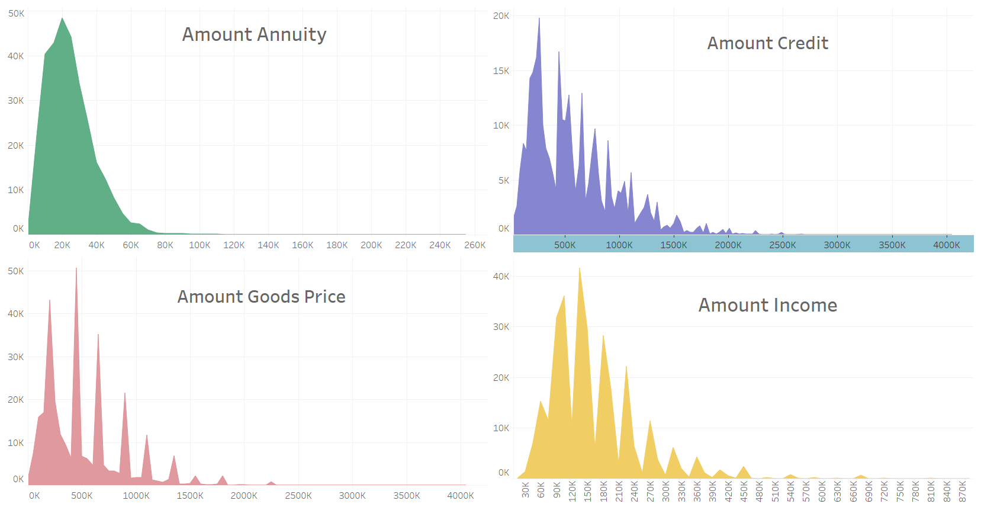

Slide 9
Base Model with imbalance target
Logistic Regression
Metrics | Training Score | Testing Score
Accuracy | 91.92 | 91.92
Precision | 0 | NA*
Recall | 0 | 0
F1_score | 0 | 0
Roc_Auc | 49.99 | 50
NA* - It’s an edge case, model hasn’t predicted any positive cases due to class imbalance

Slide 10
Base Model with balanced target
Logistic Regression
Metrics | Training Score | Testing Score
Accuracy | 57.74 | 57.83
Precision | 58.47 | 58.48
Recall | 53.63 | 53.63
F1_score | 55.94 | 55.95
Roc_Auc | 57.75 | 57.82
After performing over-sampling, we were successfully able to overcome edge case of Zero TP's and Zero FP's and have some values in precision and recall with balanced data. This can further be improved with model fine tuning.

Slide 11
Approach 1:
Min-max scaler for non-normalized features, get dummies for all features and feature integration.
Metrics/Model | Logistic Regression |  | Decision Tree
 | Train Scores | Test Scores | Train Scores | Test Scores
Accuracy | 70.55 | 70.88 | 100 | 89.67
Precision | 70.22 | 70.53 | 100 | 88.76
Recall | 71.43 | 71.59 | 100 | 90.81
f1-score | 70.82 | 71.06 | 100 | 89.78
Roc-Auc Score | 70.55 | 70.88 | 100 | 89.67

Slide 12
Approach 2:
Label encoder for multi-class variables and get dummies for binary variables, with feature engineering and Standard Scaler.
Metrics/Model | Logistic Regression |  | Decision Tree
 | Train Scores | Test Scores | Train Scores | Test Scores
Accuracy | 69.71 | 69.65 | 100 | 88.59
Precision | 69.48 | 69.41 | 100 | 87.43
Recall | 70.35 | 70.13 | 100 | 90.10
f1-score | 69.91 | 69.77 | 100 | 88.74
Roc-Auc Score | 69.71 | 69.65 | 100 | 88.59

Slide 13
PCA
Logistic Regression | Train Scores | Test Scores
Accuracy | 94.28 | 94.30
Precision | 97.29 | 97.30
Recall | 91.09 | 91.16
F1_score | 94.09 | 94.13
Roc_Auc score | 94.28 | 94.31
Principal Components are not as readable and interpretable as original features.
So we want to try with “Select KBEST” method for feature selection and proceed with model building

Slide 14
SelectKBest
Logistic Regression | Train Scores | Test Scores
Accuracy | 93.92 | 93.99
Precision | 96.90 | 97.08
Recall | 90.75 | 90.71
F1_score | 93.72 | 93.78
Roc_Auc score | 93.92 | 93.99
Going further we tried different ensemble methods on KBest model to see if we can improve the score.

Slide 15
ALGORITHMS COMPARISION (BIAS & VARIANCE ERROR) THROUGH K-FOLD CROSS VALIDATED DATA
Random Forest
Gradient Boosting
ROC_AUC = 0.965
Bias error = 0.034665
Variance Error = 0.001051
ROC_AUC = 0.963
Bias error = 0.037947
Variance Error = 0.001160
ROC_AUC = 0.974
Bias error = 0.025761
Variance Error = 0.000852
ROC_AUC = 0.976
Bias error = 0.024310
Variance Error = 0.000785
ROC_AUC = 0.967
Bias error = 0.032695
Variance Error = 0.001143
Bagging
Ada Boost
XGBoost

Slide 16
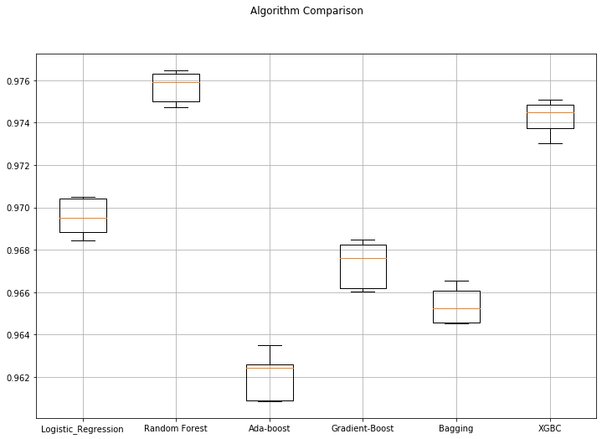
Box Plot Comparison
We observed that XGBC model is performing better on both train and test data. So we are finalizing best model as XGBC model.

Slide 17
Final Model
XGBC | Train Scores | Test Scores
Accuracy | 95.42 | 95.00
Precision | 98.85 | 98.42
Recall | 91.90 | 91.46
F1_score | 95.25 | 94.81
Roc_Auc score | 95.42 | 95.00
When we observe train and test scores, XGBoost is performing well.
Considering this model as best model

Slide 18
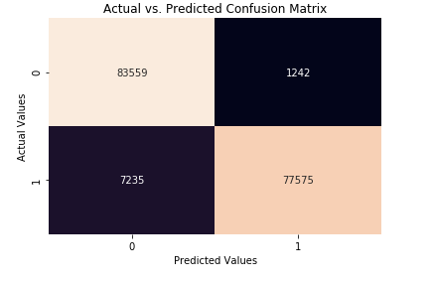
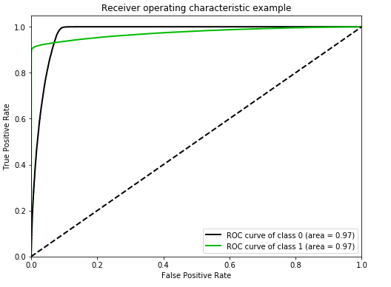

Cross-Validation Score

Slide 19
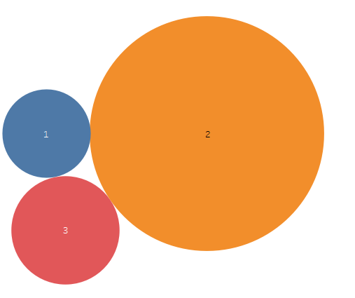
Business Insights
Region Rating
Improvements can be done in 1 rating regions

Slide 20
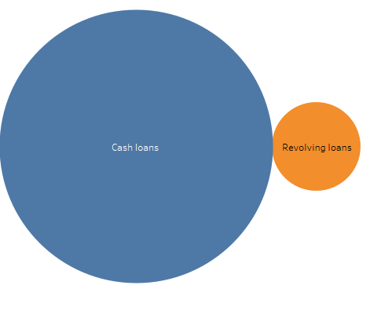
Business Insights
Loans
Better marketing for improvement of Revolving loans

Slide 21
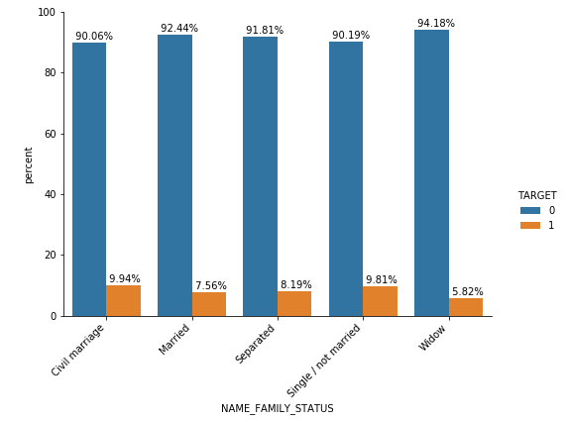
Business Insights
Family status
More Vigilant while providing loans for people with Civil marriage status

Slide 22
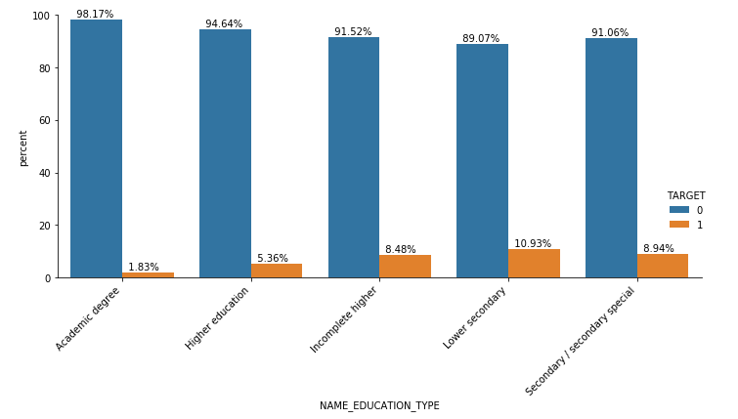
Business Insights
Family status
More awareness should be created among lower secondary and secondary education type customers

Slide 23
Limitations
Assumptions
Since the records of the dataset comprises of the data from different countries, we assumed that the currency of all the monetary features is in same units.
Different Imputation methods
Cross validation
Conclusion
Better assessment in credit risk involved in providing loan
Smoothen the borrowers experience
Understanding the customer base and the market
Scope of further analysis using Deep Learning models

Slide 24


